Slide 1
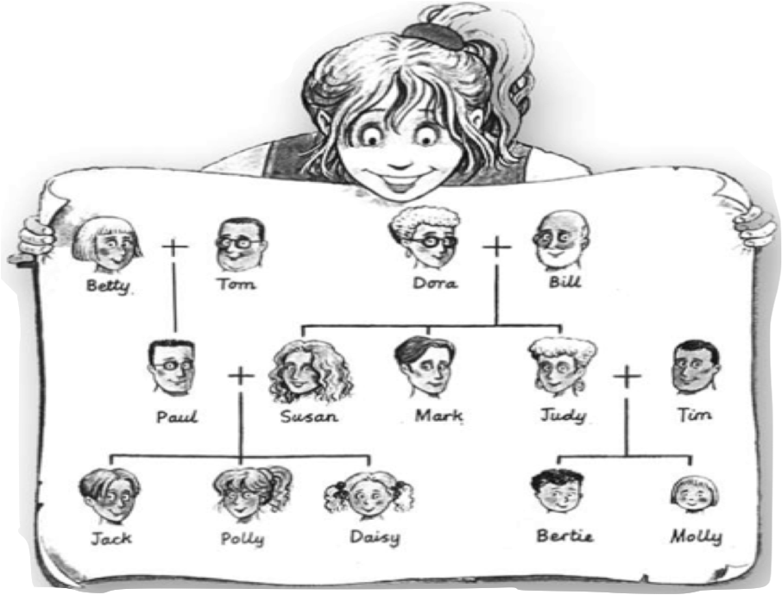
« Betty is my………………………….. »
grandparents
grandmother
mother
grandmother

Slide 2
« Daisy is my………………………….. »
aunt
sister
sister
mother

Slide 3
« Mark is my………………………….. »
brother
uncle
aunt
uncle

Slide 4
« Tom and Bill are my……………………………..….. »
brothers
grandfathers
grandfathers
uncles

Slide 5
« Paul is my………………………….. »
uncle
father
brother
father

Slide 6
« Jack is my………………………….. »
brother
brother
uncle
husband

Slide 7
« Bertie and Molly are my………………………….. »
brothers
cousins
cousins
aunts

Slide 8
« Jack is my………………………….. »
daughter
son
children
son

Slide 9
« Paul is my………………………….. »
husband
husband
children
brother

Slide 10
« Judy is my………………………….. »
sister
sister
children
brother

Slide 11
« Jack, Polly and Daisy are my………………………….. »
sister
children
children
brother

Slide 12
Dora: « Jack, Polly, Daisy, Bertie and Molly are my………………………….. »
grandmother
grandparents
grandchildren
grandchildren

Slide 13
David has got 2 sisters.
☐right
✔
☐wrong

Slide 14
Martha and Michael have got 3 daughters.
☐right
☐wrong
✔

Slide 15
David hasn’t got any brothers.
☐right
✔
☐wrong

Slide 16
Tom hasn’t got a wife.
☐right
✔
☐wrong

Slide 17
George and Mary have got 2 daughters.
☐right
☐wrong
✔

Slide 18
Sue has got a sister.
☐right
☐wrong
✔

Slide 19
Bill has got 2 uncles.
☐right
✔
☐wrong

Slide 20
Ben and Linda __________________ three cousins.
have got

Slide 21
Ben ______________ a brother.
hasn’t got

Slide 22
Susan and Paul __________________ three children.
have got

Slide 23
Ruth and John __________________ two daughters.
haven’t got

Slide 24
Timothy and Robert _____________ one sister.
have got

Slide 25
Susan ___________ a husband.
has got

Slide 26
Peter and Mary __________________ four grandchildren.
haven’t got

Slide 27
Linda ________________ a sister.
hasn’t got

Slide 28
John __________________ a sister.
has got

Slide 29
Peter and Mary __________________ four children.
haven’t got

